Slide 1
Java Spring Framework

Slide 2
What is Spring?
The Spring framework is a powerful and flexible framework focused on building Java applications.
The Spring Framework is a mature, powerful and highly flexible framework focused on building web applications in Java.
One of the core benefits of Spring is that it takes care of most of the low-level aspects of building the application to allow us to actually focus on features and business logic.

Slide 3
What Spring provides
The Spring Framework addresses the concern of organizing the basic building blocks into a coherent whole ,by providing a formalized means of composing disparate components into a fully working application ready for use.
The Spring Framework codifies formalized design patterns as first-class objects that you can integrate into your own application(s). Numerous organizations and institutions use the Spring Framework in this manner to engineer robust, maintainable applications.
Notes:
The Core Container consists of the Core, Beans, Context, and Expression Language modules.
The Core and Beans modules provide the fundamental parts of the framework, including the IoC and Dependency Injection features. TheBeanFactory is a sophisticated implementation of the factory pattern. It removes the need for programmatic singletons and allows you to decouple the configuration and specification of dependencies from your actual program logic.
The Context module builds on the solid base provided by the Core and Beans modules: it is a means to access objects in a framework-style manner that is similar to a JNDI registry. The Context module inherits its features from the Beans module and adds support for internationalization (using, for example, resource bundles), event-propagation, resource-loading, and the transparent creation of contexts by, for example, a servlet container. The Context module also supports Java EE features such as EJB, JMX ,and basic remoting. TheApplicationContext interface is the focal point of the Context module.
The Expression Language module provides a powerful expression language for querying and manipulating an object graph at runtime. It is an extension of the unified expression language (unified EL) as specified in the JSP 2.1 specification. The language supports setting and getting property values, property assignment, method invocation, accessing the context of arrays, collections and indexers, logical and arithmetic operators, named variables, and retrieval of objects by name from Spring's IoC container. It also supports list projection and selection as well as common list aggregations.

Slide 4
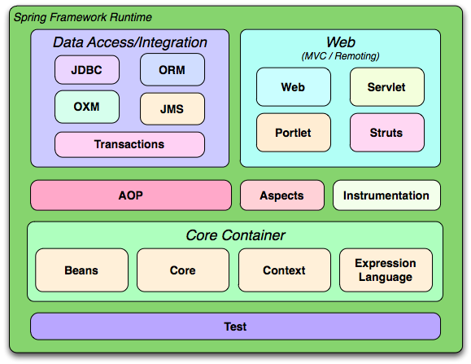
Spring Modules and Architecture
Notes:
Although the Java platform provides a wealth of application development functionality, it lacks the means to organize the basic building blocks into a coherent whole, leaving that task to architects and developers. True, you can use design patterns such as Factory, Abstract Factory, Builder, Decorator, and Service Locatorto compose the various classes and object instances that make up an application. However, these patterns are simply that: best practices given a name, with a description of what the pattern does, where to apply it, the problems it addresses, and so forth. Patterns are formalized best practices that you must implement yourself in your application.
https://docs.spring.io/spring/docs/3.0.x/spring-framework-reference/html/overview.html

Slide 5
Spring /IOC
IoC is also known as dependency injection (DI). It is a process whereby objects define their dependencies, that is, the other objects they work with, only through constructor arguments, arguments to a factory method, or properties that are set on the object instance after it is constructed or returned from a factory method.
The container then injects those dependencies when it creates the bean. This process is fundamentally the inverse, hence the name Inversion of Control (IoC), of the bean itself controlling the instantiation or location of its dependencies by using direct construction of classes, or a mechanism such as the Service Locator pattern.

Slide 6
Dependency Injection
Java components / classes should be as independent as possible of other Java classes. This increases the possibility to reuse these classes and to test them independently of other classes(Unit Testing). To decouple Java components from other Java components the dependency to a certain other class should get injected into them rather that the class itself creates / finds this object. A class A has a dependency to class B if class uses class B as a variable.
If dependency injection is used then the class B is given to class A via
the constructor of the class A - this is then called construction injection
a setter - this is then called setter injection
The general concept between dependency injection is called Inversion of Control. A class should not configure itself but should be configured from outside.

Slide 7
public class Store {
private Item item;
public Store() {
item = new ItemImpl1();
}
}
Without DI
Constructor Injection
public class Store {
private Item item;
public Store(Item item) {
this.item = item;
}
public setItem(Item item)
{
this.item=item;
}
Setter Injection

Slide 8
Spring Maven Dependencies
<dependency>
<groupId>org.springframework</groupId>
<artifactId>spring-webmvc</artifactId>
<version>4.0.3.RELEASE</version>
</dependency>
<dependency>
<groupId>org.hibernate</groupId>
<artifactId>hibernate- entitymanager</artifactId>
<version>4.3.5.Final</version>
</dependency>
<dependency>
<groupId>org.springframework</groupId>
<artifactId>spring-orm</artifactId>
<version>4.0.3.RELEASE</version>
</dependency>
<dependency> <groupId>org.springframework</groupId> <artifactId>spring-context</artifactId> <version>4.0.3.RELEASE</version> </dependency> <dependency> <groupId>org.springframework</groupId> <artifactId>spring-webmvc</artifactId> <version>4.0.3.RELEASE</version> </dependency>

Slide 9
<?xml version="1.0" encoding="UTF-8"?>
<beans
xmlns="http://www.springframework.org/schema/beans"
xmlns:xsi="http://www.w3.org/2001/XMLSchema-instance"
xmlns:p="http://www.springframework.org/schema/p"
xsi:schemaLocation="http://www.springframework.org/schema/beans
http://www.springframework.org/schema/beans/spring-beans-3.0.xsd">
<bean id="book" class="com.spring.example.Book">
<constructor-arg value="1" type="int"></constructor-arg>
</bean>
<bean id="book1" class="com.spring.example.Book">
<property name="id">
<value>1</value>
</property>
</beans>
Constructor Injection
Setter Injection

Slide 10
This scopes the bean definition to a single instance per Spring IoC container
<!-- A bean definition with singleton scope -->
<bean id = "..." class = "..." scope = "singleton">
</bean
prototype
This scopes a single bean definition to have any number of object instances
request
This scopes a bean definition to an HTTP request. Only valid in the context of a web-aware Spring ApplicationContext.
session
This scopes a bean definition to an HTTP session. Only valid in the context of a web-aware Spring ApplicationContext.

Slide 11
Spring Hello World
Steps
Create the Bean Class
Create a xml file to configure the Bean class
Write a Client

Slide 12
package com.myapp.core;
public class HelloWorld {
private String name;
public void setName(String name) {
this.name = name;
}
public void printHello() {
System.out.println("Spring 3 : Hello ! " + name);
}
}
HelloWorld.java
SpringBeans.xml
<beans xmlns="http://www.springframework.org/schema/beans"
xmlns:xsi="http://www.w3.org/2001/XMLSchema-instance"
xsi:schemaLocation="http://www.springframework.org/schema/beans
http://www.springframework.org/schema/beans/spring-beans-3.0.xsd">
<bean id="helloBean" class="com.myapp.core.HelloWorld">
<property name="name" value="Java" />
</bean>
</beans>

Slide 13
Test Client
public class App {
public static void main(String[] args) {
ApplicationContext context = new ClassPathXmlApplicationContext(
"SpringBeans.xml");
HelloWorld obj = (HelloWorld) context.getBean("helloBean");
obj.printHello();
}
}

Slide 14
DI Example
public interface OperationI {
public int operate(int x,int y);
}
public class AOperate implements OperationI {
@Override
public int operate(int x, int y) {
return x+y;
}}
public class MOperate implements OperationI {
@Override
public int operate(int x, int y) {
return x*y;
}
}

Slide 15
DI - Demo
public class OperationDemo {
private OperationI oInterface;
public void init()
{
System.out.println("Init...");
}
public OperationI getoInterface() {
return oInterface;
}
public void setoInterface(OperationI oInterface) {
this.oInterface = oInterface;
}
public int getOperation(int x,int y)
{
return oInterface.operate(x, y);
}
public void destroy()
{
System.out.println("Destroy...");
}
}

Slide 16
//Client Code
ApplicationContext context =
new ClassPathXmlApplicationContext("beans2.xml");
OperationDemo demo=(OperationDemo) context.getBean("operationDemo");
System.out.println(demo.getOperation(12, 5));
//beans2.xml
<bean id="operationId"
class="com.classes.MOperate">
</bean>
<bean id="operationDemo"
class="com.classes.OperationDemo">
<property name="oInterface" ref="operationId"></property>
</bean>

Slide 17
AutoWiring
There are different ways through which we can autowire a spring bean.
autowire byName – For this type of autowiring, setter method is used for dependency injection. Also the variable name should be same in the class where we will inject the dependency and in the spring bean configuration file.
autowire byType – For this type of autowiring, class type is used. So there should be only one bean configured for this type in the spring bean configuration file.
autowire by constructor – This is almost similar to autowire byType, the only difference is that constructor is used to inject the dependency.

Slide 18
Bean LifeCycle
<bean id="operationDemo"
class="com.classes.OperationDemo" autowire="byType" init-method="init" destroy-method="destroy">
<!-- <property name="oInterface" ref="operationId"></property> -->
</bean>
Before the business logic executes init-method is called as soon as the bean is loaded into memory.
Before the bean is deallocated destroy method is called.

Slide 19
Bean LifeCycle
<bean id = "helloWorld" class = "com.tutorialspoint.HelloWorld" init-method = "init"
destroy-method = "destroy">
<property name = "message" value = "Hello World!"/>
</bean>
public class HelloWorld {
private String message;
public void setMessage(String message){
this.message = message;
}
public void getMessage(){
System.out.println("Your Message : " + message);
}
public void init(){
System.out.println("Bean is going through init.");
}
public void destroy() {
System.out.println("Bean will destroy now.");
}
}
public class MainApp {
public static void main(String[] args) {
AbstractApplicationContext context = new ClassPathXmlApplicationContext("Beans.xml");
HelloWorld obj = (HelloWorld) context.getBean("helloWorld");
obj.getMessage();
context.registerShutdownHook();
}
}
Output:
Bean is going through init.
Your Message : Hello World!
Bean will destroy now.

Slide 20
Collection Injection
<property name="addressList">
<list>
<value>INDIA</value>
<value>Pakistan</value>
<value>USA</value>
<value>USA</value>
</list>
</property>
<property name="addressSet">
<set>
<value>INDIA</value>
<value>Pakistan</value>
<value>USA</value>
<value>USA</value>
</set>
</property>
<property name="addressMap">
<map>
<entry key="1" value="NDIA"/>
<entry key="2" value="Pakistan"/>
<entry key="3" value="USA"/>
<entry key="4" value="USA"/>
</map>
</property>
<property name="addressProp">
<props>
<prop key="one">INDIA</prop>
<prop key="two">Pakistan</prop>
<prop key="three">USA</prop>
<prop key="four">USA</prop>
</props>
</property>

Slide 21
BeanPostProcessor
A bean post processor allows additional processing before and after the bean initialization callback method. The main characteristic of a bean post processor is that it will process all the bean instances in the IoC container one by one, not just a single bean instance.
Typically, bean post processors are used for checking the validity of bean properties or altering bean properties according to certain criteria.
Steps:
implement the BeanPostProcessor interface.
implement postProcessBeforeInitialization() and postProcessAfterInitialization() methods.
public class CustomBeanPostProcessor implements BeanPostProcessor
{
public Object postProcessBeforeInitialization(Object bean, String beanName) throws BeansException
{
System.out.println("Called postProcessBeforeInitialization() for :" + beanName);
return bean;
}
public Object postProcessAfterInitialization(Object bean, String beanName) throws BeansException
{
System.out.println("Called postProcessAfterInitialization() for :" + beanName);
return bean;
}
}

Slide 22
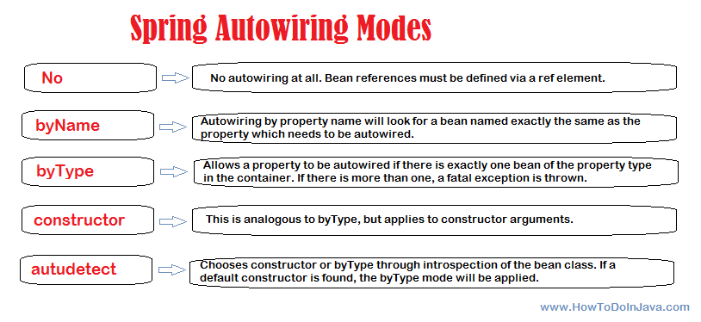
Spring Bean Autowiring
<bean id="employee" class="com.classes.EmployeeBean" autowire="byType">
<property name=“name" value=“sam"/>
</bean>
<bean id="department" class="com.classes.DepartmentBean" >
<property name="name" value="Human Resource" />
</bean>

Slide 23
Use @Qualifier for conflict in dependency resolution
public class EmployeeBean
{
@Autowired
@Qualifier("finance")
private DepartmentBean departmentBean;
public DepartmentBean getDepartmentBean() {
return departmentBean;
}
public void setDepartmentBean(DepartmentBean departmentBean) {
this.departmentBean = departmentBean;
}
//More code
}
beans.xml
<bean id="employee" class=“com.classes.EmployeeBean" autowire="constructor">
<!--First bean of type DepartmentBean-->
<bean id="humanResource" class="com.classes.DepartmentBean" >
<property name="name" value="Human Resource" />
</bean>
<!--Second bean of type DepartmentBean-->
<bean id="finance" class="com.classes.DepartmentBean" >
<property name="name" value="Finance" />
</bean>
</beans>

Slide 24
@Configuration and @Bean
To declare a bean, simply annotate a method with the @Bean annotation. When JavaConfig encounters such a method, it will execute that method and register the return value as a bean within a BeanFactory. By default, the bean name will be the same as the method name (see bean naming for details on how to customize this behavior). The following is a simple example of a @Bean method declaration:
@Configuration
public class AppConfig {
@Bean
public TransferService transferService() {
return new TransferServiceImpl();
}
}
For comparison sake, the configuration above is exactly equivalent to the following Spring XML:
<beans>
<bean name="transferService" class="com.acme.TransferServiceImpl"/>
</beans>

Slide 25
Working with Spring FactoryBean implementations
Spring provides many implementations of the FactoryBean interface. Usually these classes are used to support integrations with other frameworks. Take for example org.springframework.orm.hibernate3.LocalSessionFactoryBean. This class is used to create a Hibernate SessionFactory and requires as dependencies the location of Hibernate mapping files and a DataSource. Here's how it is commonly used in XML:
<beans>
<bean id="sessionFactory"
class="org.springframework.orm.hibernate3.LocalSessionFactoryBean">
<property name="dataSource" ref="dataSource"/>
<property name="mappingResources">
<list>
<value>com/acme/Bank.hbm.xml</value>
<value>com/acme/Account.hbm.xml</value>
<value>com/acme/Customer.hbm.xml</value>
</list>
</property>
</bean>
<bean id="dataSource" class="...">
<!-- ... -->
</bean>
</beans>

Slide 26
@Component, @Repository, @Service and @Controller annotations
The @Component annotation marks a java class as a bean so the component-scanning mechanism of spring can pick it up and pull it into the application context. To use this annotation, apply it over class as below:
@Component
public class EmployeeDAOImpl implements EmployeeDAO {
...
}
@Repository Annotation
Although above use of @Component is good enough but we can use more suitable annotation that provides additional benefits specifically for DAOs i.e. @Repository annotation. The @Repository annotation is a specialization of the @Component annotation with similar use and functionality. In addition to importing the DAOs into the DI container, it also makes the unchecked exceptions (thrown from DAO methods) eligible for translation into Spring DataAccessException.

Slide 27
@Service Annotation
The @Service annotation is also a specialization of the component annotation. It doesn’t currently provide any additional behavior over the @Component annotation, but it’s a good idea to use @Service over @Component in service-layer classes because it specifies intent better. Additionally, tool support and additional behavior might rely on it in the future.
@Controller Annotation
@Controller annotation marks a class as a Spring Web MVC controller. It too is a @Component specialization, so beans marked with it are automatically imported into the DI container. When we add the @Controller annotation to a class, we can use another annotation i.e. @RequestMapping; to map URLs to instance methods of a class.

